Slide 1
Olympic Games
A whistle stop tour

Slide 2
Brief History
First games had one event – a race in 766 BC in Greece
The Romans banned the games when they conquered Greece in 393 AD
International Olympic Committee was formed in 1894
The first modern Olympics held in Athens in 1896

Slide 3
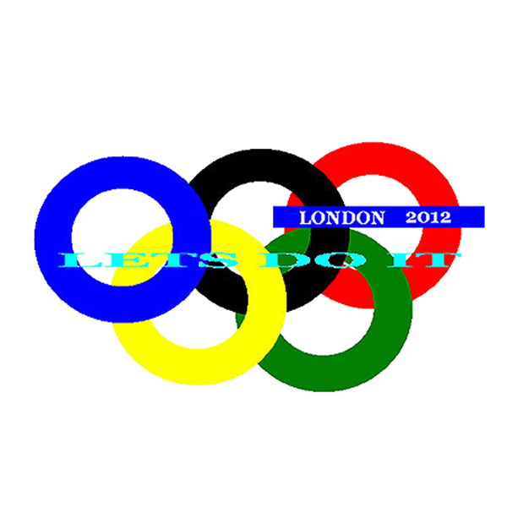



London Olympics 2012

Slide 4
Making Things Happen
Plan
Review
Do

Slide 5
Who? What? Where? When? Why?
When does planning start?
Who does the planning?
What has to be planned?
When does the planning get reviewed?
What questions can you add to the list?

